Slide 1
Sales Analysis Dashboard

Slide 2
agenda
Dashboard Overview
Country-wise Sales
Monthly Revenue Trend
Profit by Product
Revenue by Product
Revenue vs. Profit Comparison
Visual Insights Summary

Slide 3
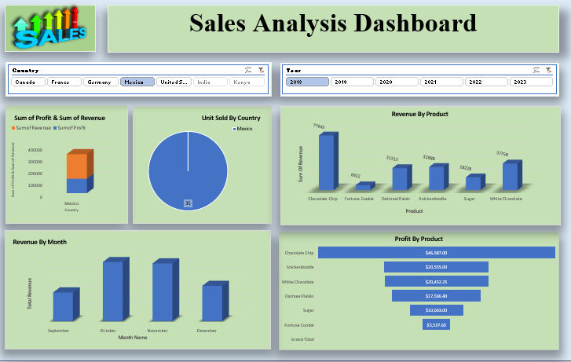
Dashboard Overview

Slide 4
Country-wise Sales

Slide 5
Monthly Revenue Trend

Slide 6
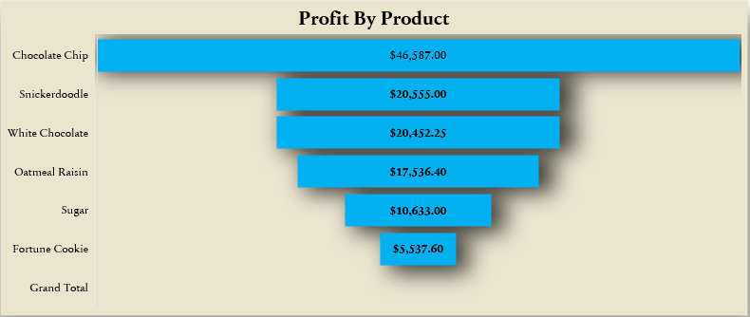
Profit by Product

Slide 7
Revenue by Product

Slide 8
Revenue vs. Profit Comparison

Slide 9
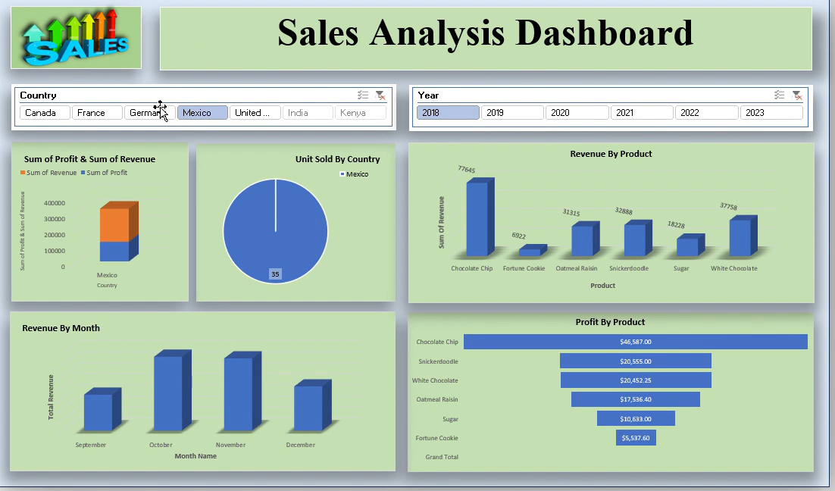
Visual Insights Summary

Slide 10
Thank you
Prathmesh Navale

